Slide 1
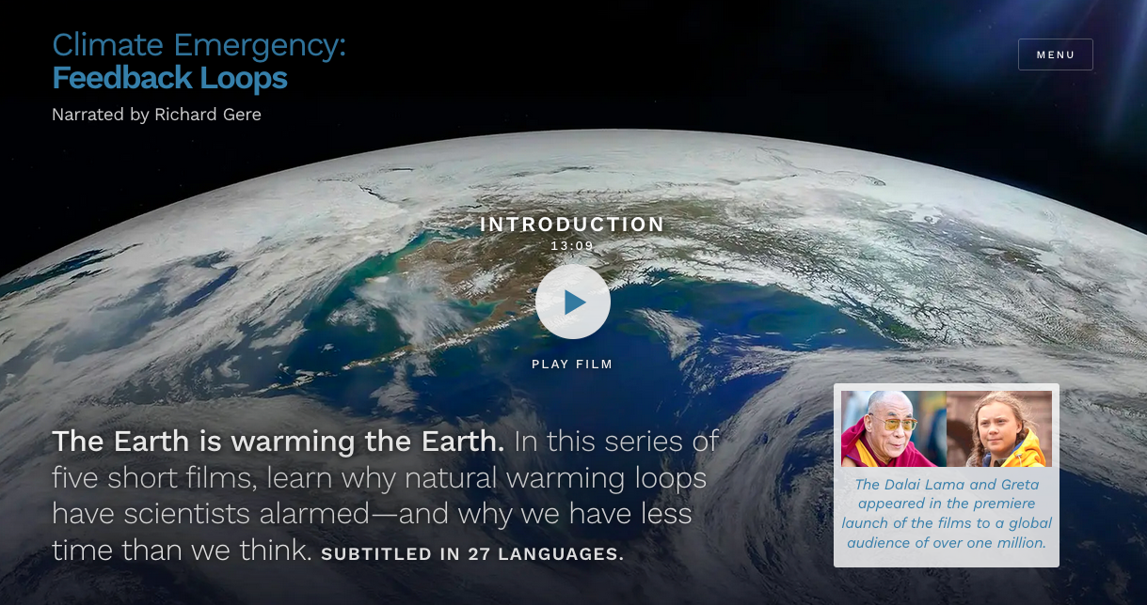
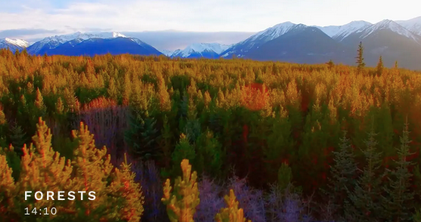
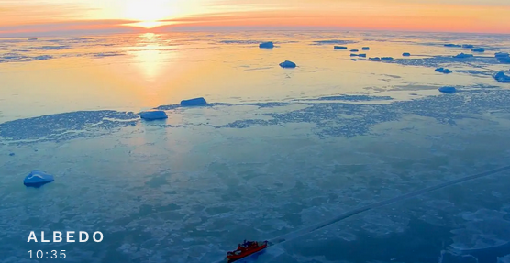
The Climate Emergency films
Climate Emergency: Feedback Loops
Director/Co-Writer: Susan Gray
~2021

Slide 2
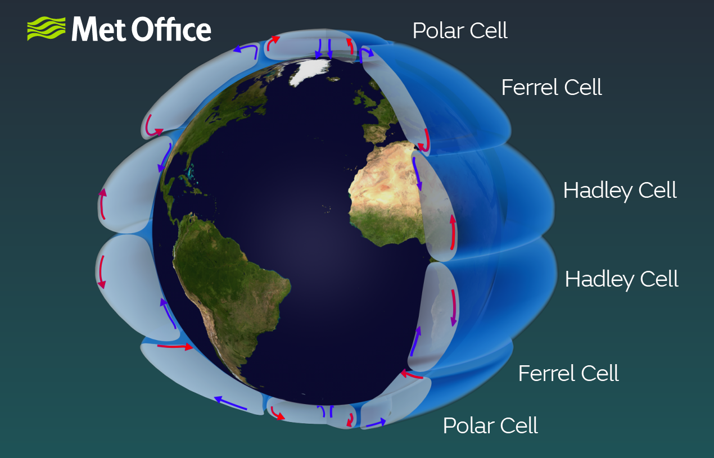
Following up on Ke et al:
What is the timing of these risks (terrestrial, Arctic) according to the Climate Emergency scientists?
What is the timing of these risks according to Ke et al?
Why wet regions will get wetter, dry regions drier; high pressure, low pressure systems; acceleration due to warming

Slide 3
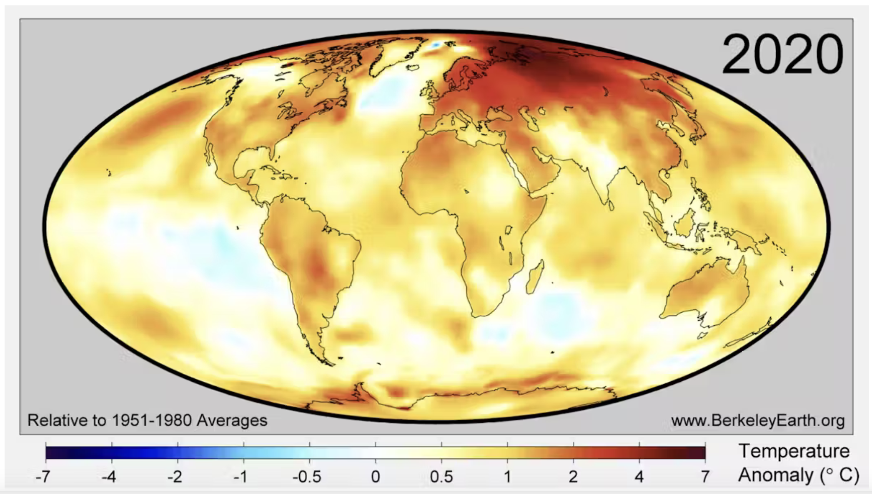
We mentioned Polar amplification before …

Slide 4
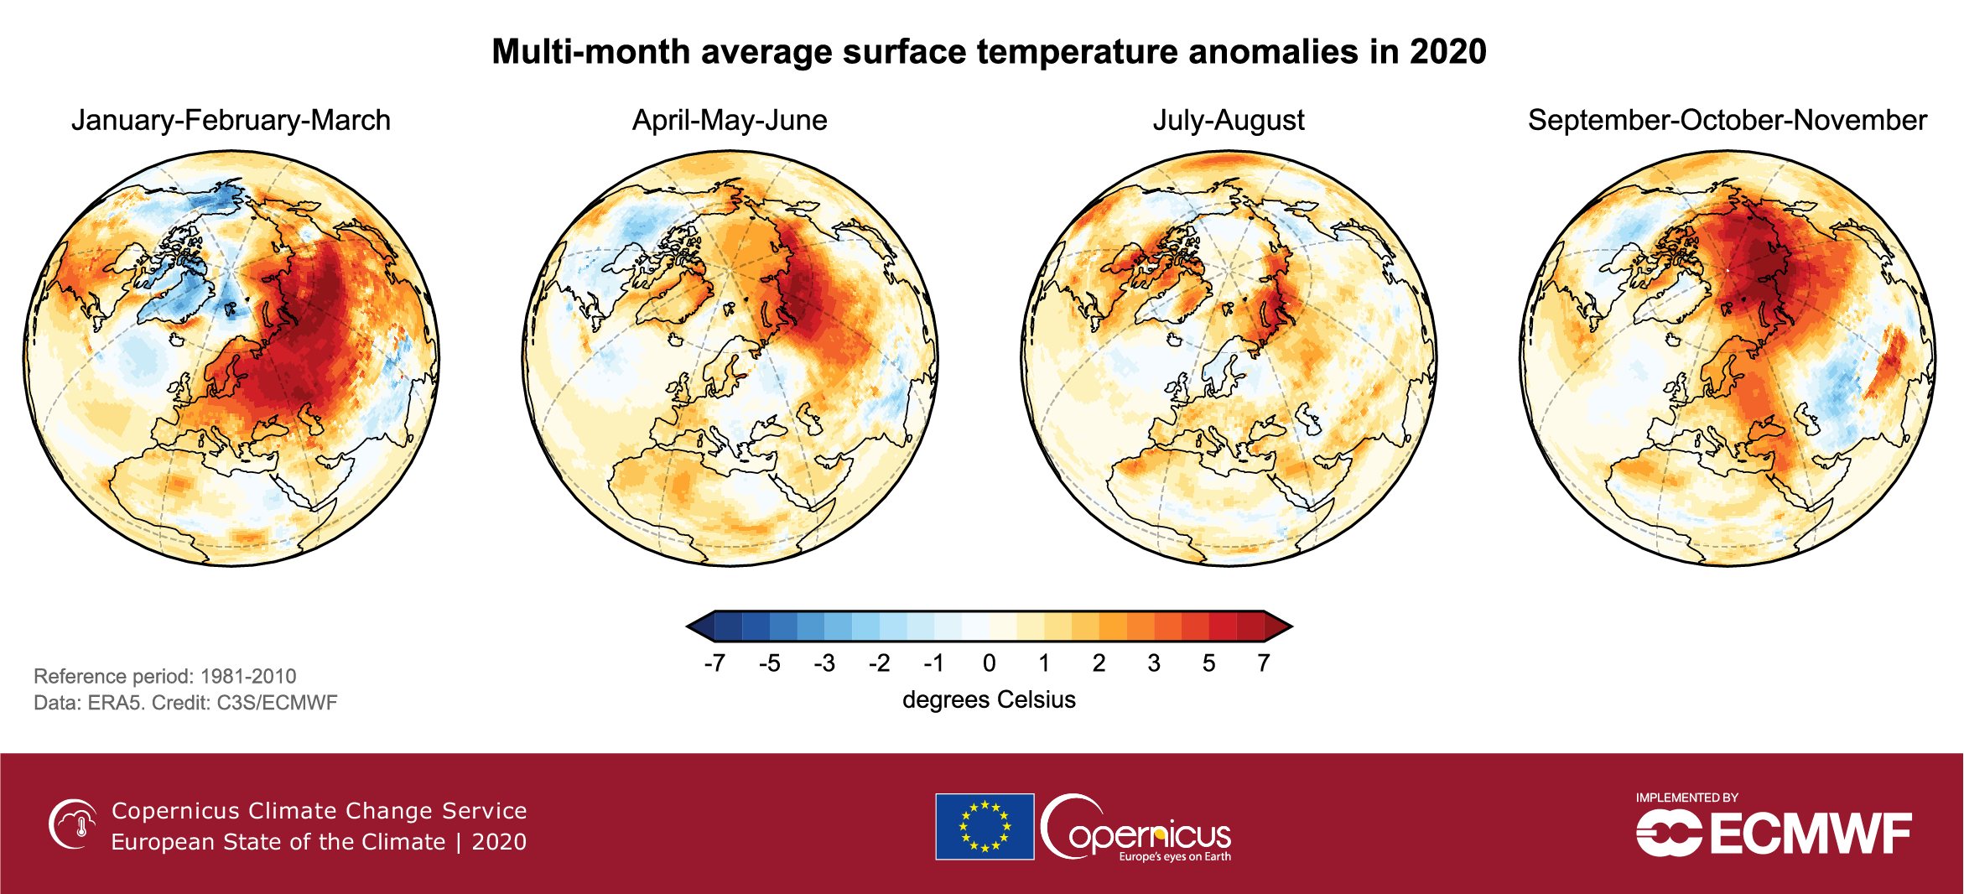
… but less about the mechanism behind Polar Amplification
Some take-home insights …
In winter and spring, reduction in land-based ice and snow is driving warming.
In the summer and fall, reduction in sea ice are driving warming.
(Changes in clouds are also affecting things, but that’s a big unknown.)

Slide 5



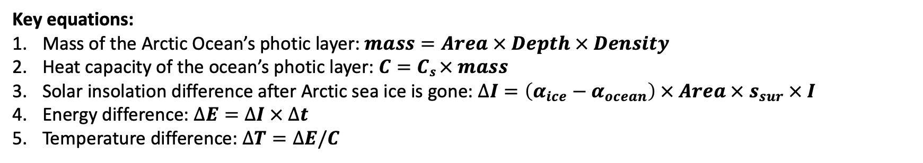
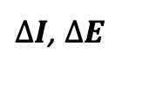
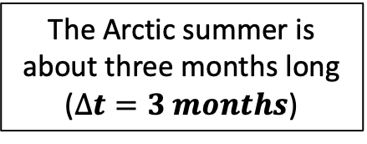


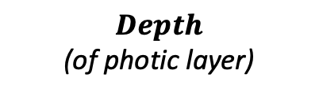

The Arctic summer is about three months long ($∆t=3 months$)
$$I$$
clouds
$$s_{sur}$$
$α$_{ocean}
$Area$ (of ice-covered Arctic Ocean)
$α$_{ice}
$∆I$, $∆E$
Seawater has a known $Density$ and
specific heat capacity ($C_{s}$)
$Depth$
(of photic layer)
Key equations:
Mass of the Arctic Ocean’s photic layer: $mass=Area × Depth × Density$
Heat capacity of the ocean’s photic layer: $C=Cs × mass$
Solar insolation difference after Arctic sea ice is gone: $∆I=\left(α_{ice}−α_{ocean}\right) × Area × s_{sur} × I$
Energy difference: $∆E=∆I × ∆t$
Temperature difference: $∆T=∆E/C$

Slide 6
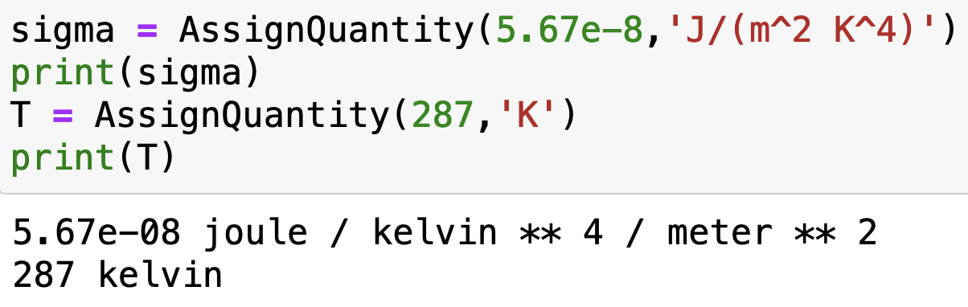
Using pint
Here’s how you bring pint into your Python notebook
Super-handy because AssignQuantity attaches units for you:

Slide 7
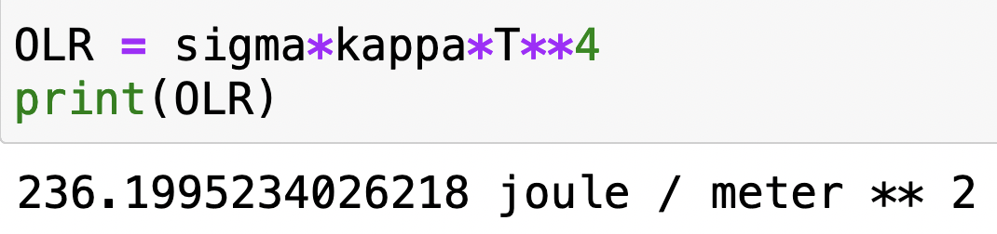
Using pint
pint also calculates units of the results of calculations:

Slide 8
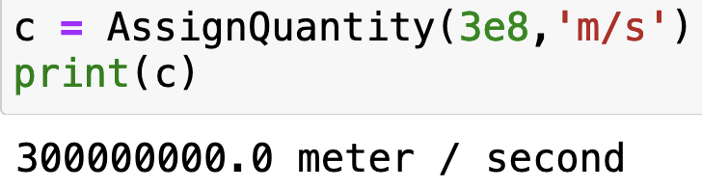
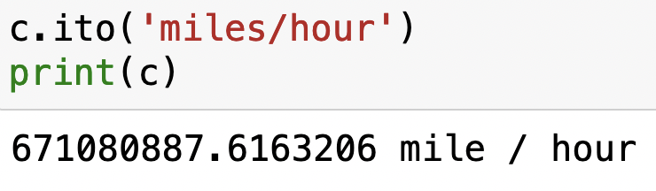
Using pint
pint can also do conversions for you, using “.ito”

Slide 9
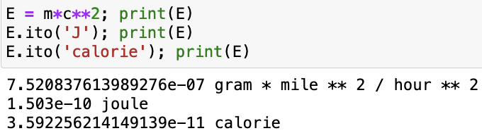
Using pint
Conversions can be very handy for unraveling calculations in crazy units. For example, Einstein’s formula for the equivalence of mass and energy is
$$E=mc^{2}$$
What if you specified mass in grams and speed in miles/hour? The result would have units gram mile² / hour², right? But nobody thinks about energy in those units, they think about energy in joules (or calories or btu or ergs ...). Fortunately, pint knows a lot of units:

